Slide 1


浙江大学伊利诺伊大学厄巴纳香槟校区联合学院
Zhejiang University-University of Illinois at Urbana Champaign Institute
ECE 448: Artificial Intelligence
Lecture 26 Final Review
Prof. Hongwei Wang hongweiwang@intl.zju.edu.cn
Prof. Mark Hasegawa-Johnson jhasegaw@illinois.edu
Spring 2023
Notes:
Introduction of Undergraduate Education at Zhejiang University-University of Illinois at Urbana Champaign Institute

Slide 2
Outline: Final Review
Key Concept Part I
Key Concept Part II
Key Concept Part III
Key Concept Part IV
Final Agenda

Slide 3
Outline: Final Review
Key Concept Part I
Key Concept Part II
Key Concept Part III
Key Concept Part IV
Final Agenda

Slide 4
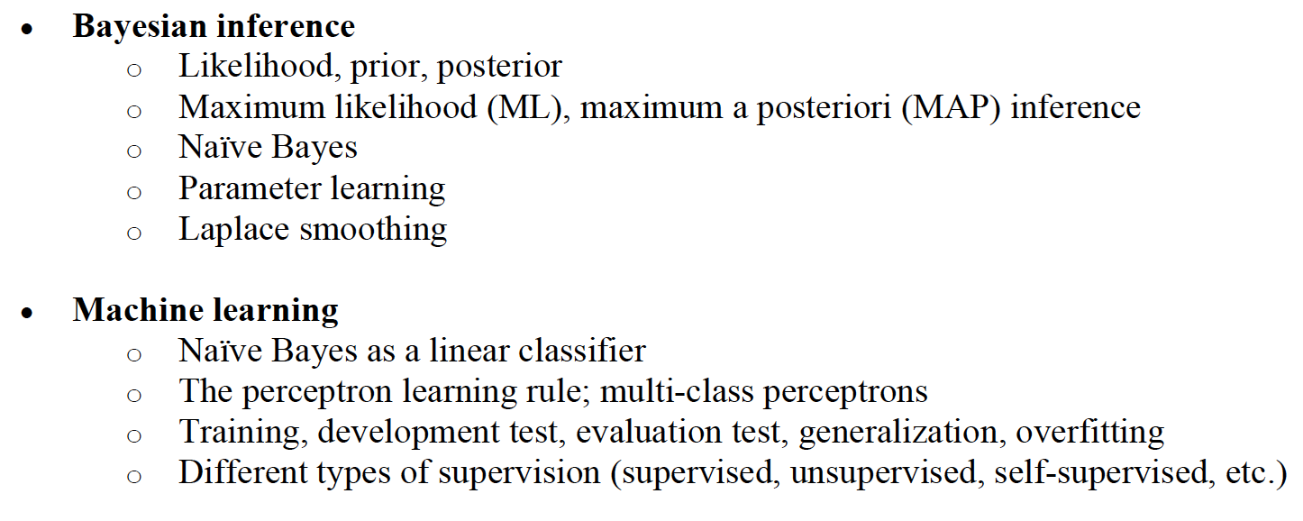
Key Concepts Part I

Slide 5
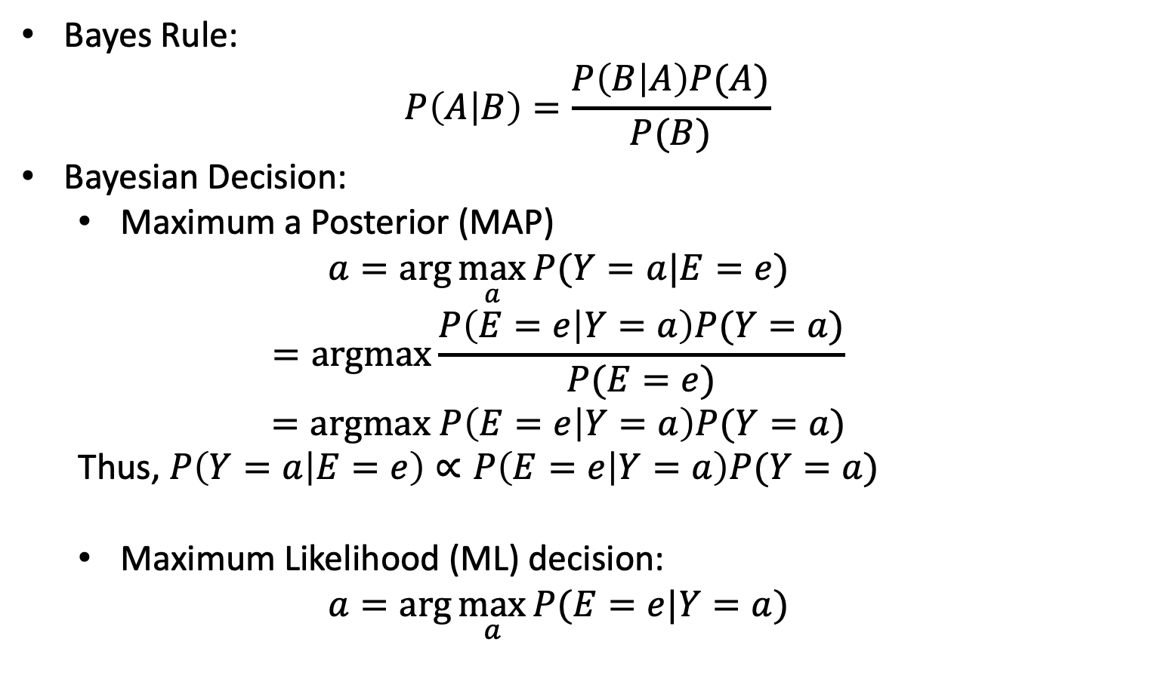
Bayesian Inference
Bayes Rule:
$$P\left(A | B\right)=\frac{P\left(B | A\right)P(A)}{P(B)}$$
Bayesian Decision:
Maximum a Posterior (MAP)
$$a=arg\max_{a}{P(Y=a|E=e)}$$
$$=argmax\frac{P\left(E=e | Y=a\right)P(Y=a)}{P(E=e)}$$
$$=argmax P\left(E=e | Y=a\right)P(Y=a)$$
Thus, $P\left(Y=a | E=e\right)∝P\left(E=e | Y=a\right)P(Y=a)$
Maximum Likelihood (ML) decision:
$$a=arg\max_{a}{P(E=e|Y=a)}$$
posterior
likelihood
prior

Slide 6
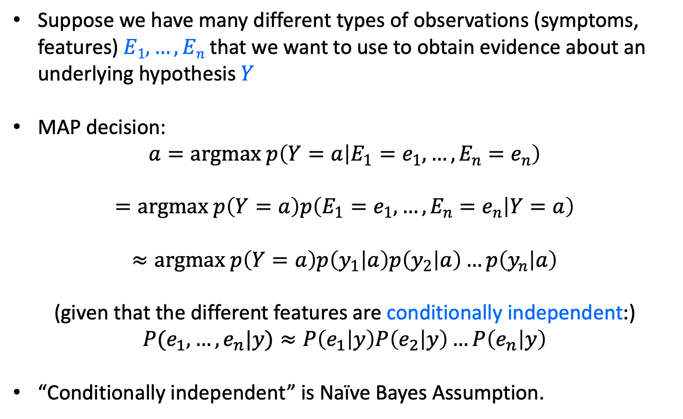
Naïve Bayes Model
Suppose we have many different types of observations (symptoms, features) $E1, …, En$that we want to use to obtain evidence about an underlying hypothesis $Y$
MAP decision: $a=argmax p\left(Y=a | E_{1}=e_{1},…,E_{n}=e_{n}\right)$
$$=argmax p\left(Y=a\right)p\left(E_{1}=e_{1},…,E_{n}=e_{n} | Y=a\right)$$
$$≈argmax p\left(Y=a\right)p\left(y_{1} | a\right)p\left(y_{2} | a\right)…p\left(y_{n} | a\right)$$
(given that the different features are conditionally independent:)
$$P(e_{1},…, e_{n}|y)≈P\left(e_{1} | y\right)P\left(e_{2} | y\right)…P\left(e_{n} | y\right)$$
“Conditionally independent” is Naïve Bayes Assumption.

Slide 7
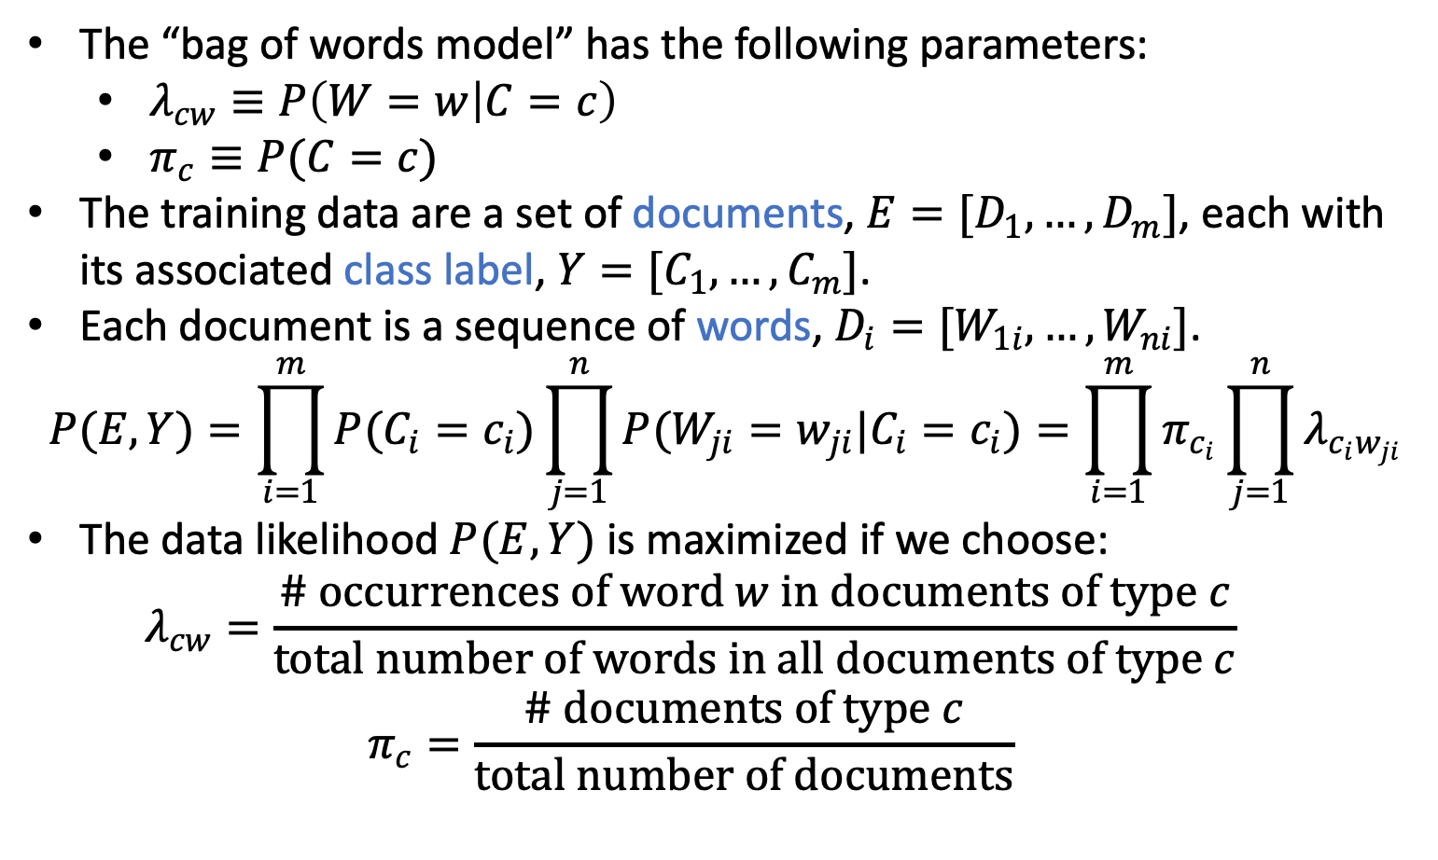
Bayes Learning: Bag of Words model
The “bag of words model” has the following parameters:
$λ_{cw}≡P\left(W=w | C=c\right)$
$π_{c}≡P(C=c)$
The training data are a set of documents, ${E=[D}_{1},…,D_{m}]$, each with its associated class label, ${Y=[C}_{1},…,C_{m}]$.
Each document is a sequence of words, $D_{i}=[W_{1i},…,W_{ni}]$.
$$P(E,Y)=\prod_{i=1}^{m}{P(C_{i}=c_{i})\prod_{j=1}^{n}{P(W_{ji}=w_{ji}|C_{i}=c_{i})}}=\prod_{i=1}^{m}{π_{c_{i}}\prod_{j=1}^{n}{λ_{c_{i}w_{ji}}}}$$
The data likelihood $P(E,Y)$ is maximized if we choose:
$$λ_{cw}=\frac{\# occurrences of word w in documents of type c}{total number of words in all documents of type c}$$
$$π_{c}=\frac{\# documents of type c}{total number of documents}$$

Slide 8
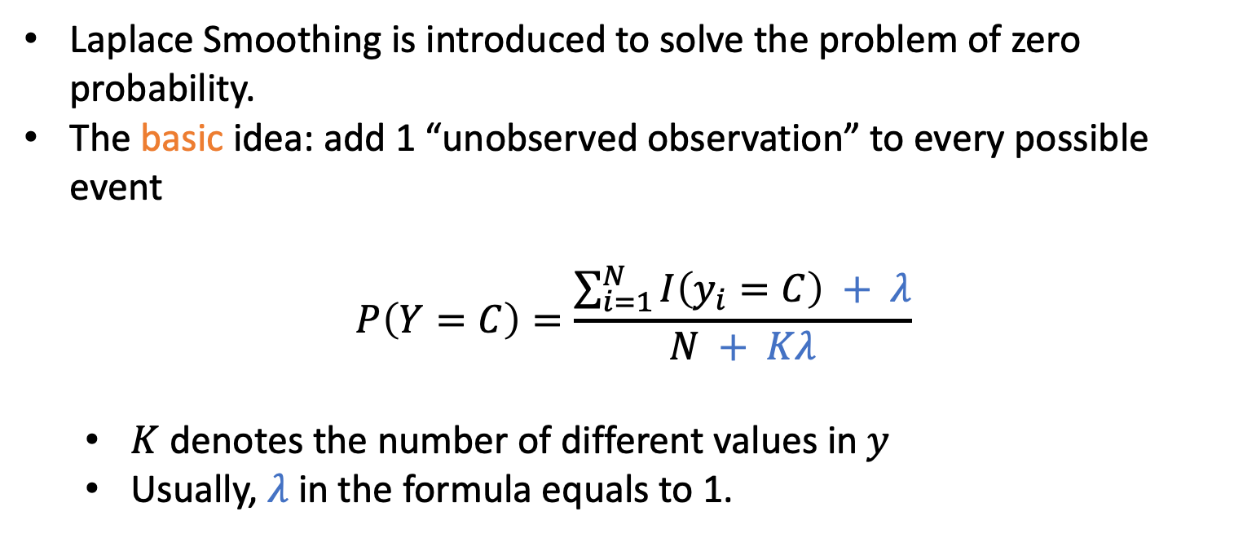
Laplace Smoothing
Laplace Smoothing is introduced to solve the problem of zero probability.
The basic idea: add 1 “unobserved observation” to every possible event
$$P\left(Y=C\right)=\frac{\sum_{i=1}^{N}{I\left(y_{i}=C\right) + λ}}{N + Kλ}$$
$K$ denotes the number of different values in$y$
Usually, $λ$ in the formula equals to 1.

Slide 9
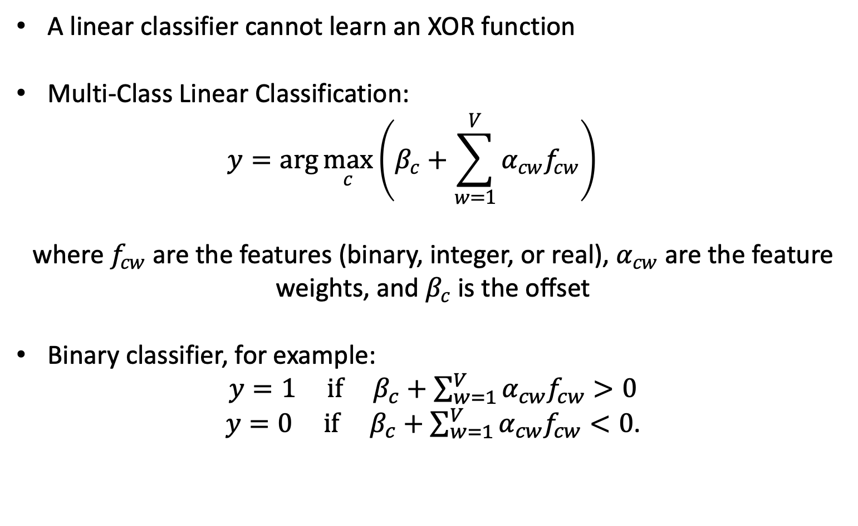
Linear Classifier
A linear classifier cannot learn an XOR function
Multi-Class Linear Classification:
$$y=arg\max_{c}\left(β_{c}+\sum_{w=1}^{V}{α_{cw}f_{cw}}\right)$$
where $f_{cw}$ are the features (binary, integer, or real), $α_{cw}$ are the feature weights, and $β_{c}$ is the offset
Binary classifier, for example:
${y=1 if β}_{c}+\sum_{w=1}^{V}{α_{cw}f_{cw}}>0$
${y=0 if β}_{c}+\sum_{w=1}^{V}{α_{cw}f_{cw}}<0$.

Slide 10
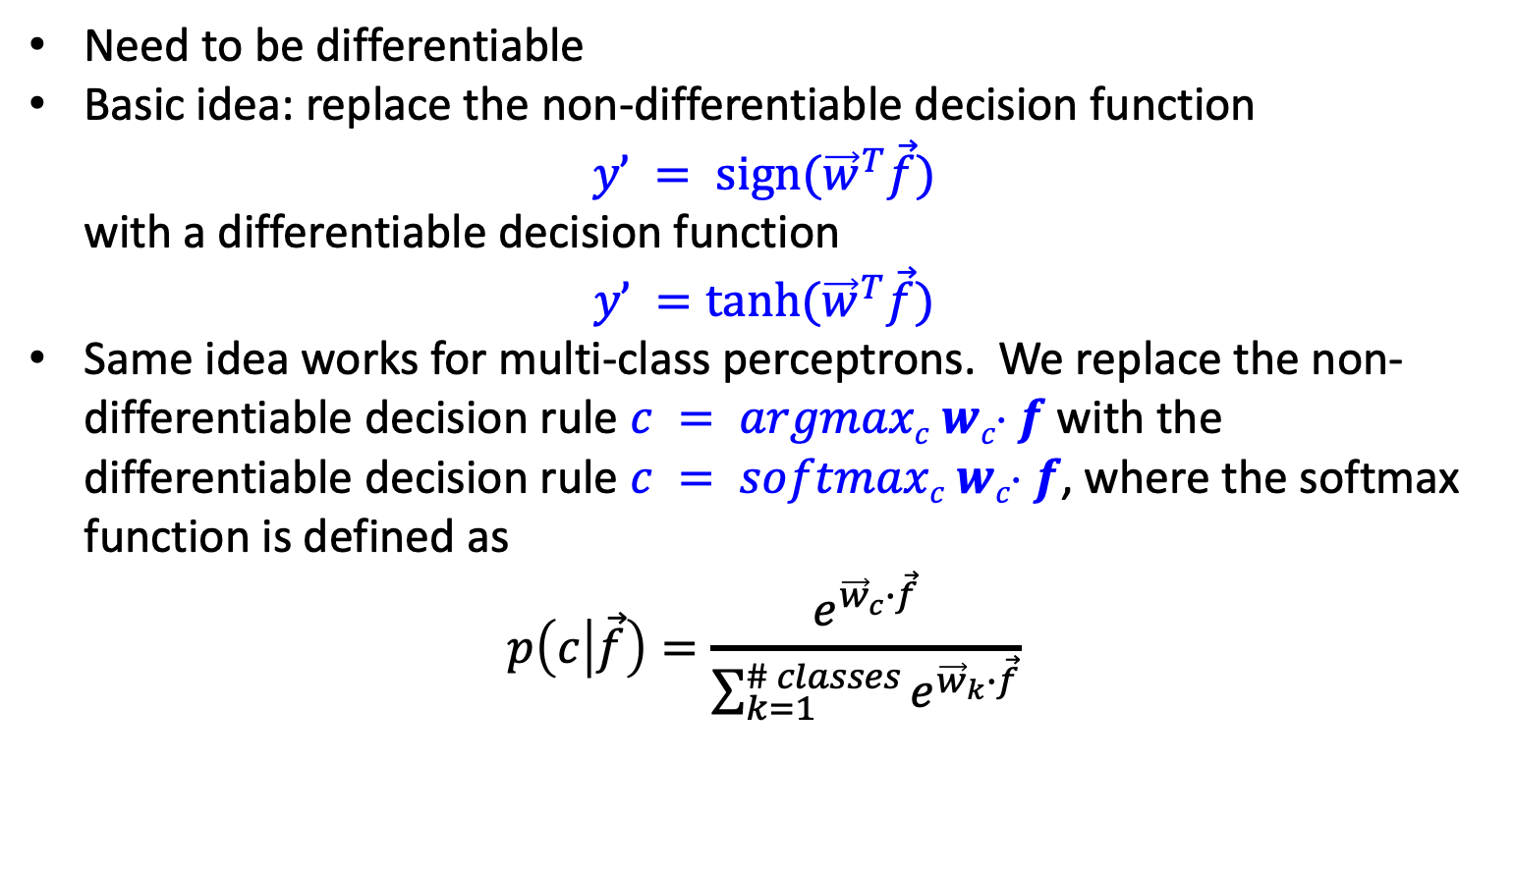
Perceptron
Need to be differentiable
Basic idea: replace the non-differentiable decision function
$$y’ = sign({\vec{w}}^{T}\vec{f})$$
with a differentiable decision function
$y’ =tanh({\vec{w}}^{T}\vec{f})$
Same idea works for multi-class perceptrons. We replace the non-differentiable decision rule $c = argmaxc wc f$with the differentiable decision rule $c = softmaxc wc f$, where the softmax function is defined as
$$p\left(c | \vec{f}\right)=\frac{e^{{\vec{w}}_{c}∙\vec{f}}}{\sum_{k=1}^{\# classes}{e^{{\vec{w}}_{k}∙\vec{f}}}}$$

Slide 11
Outline: Final Review
Key Concept Part I
Key Concept Part II
Key Concept Part III
Key Concept Part IV
Final Agenda

Slide 12
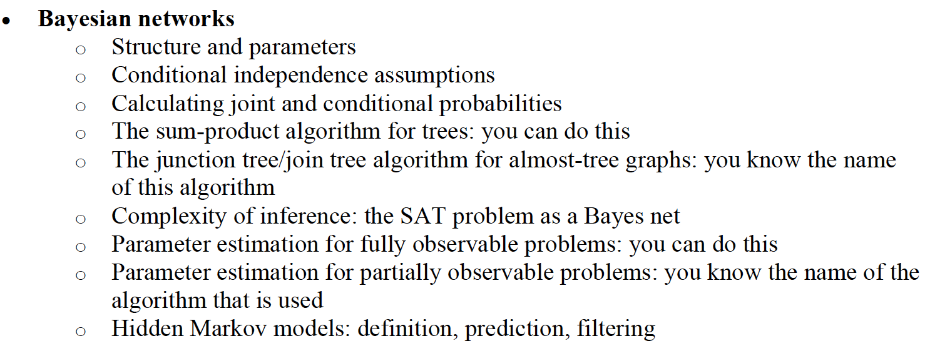
Key Concepts Part II

Slide 13
Product rule
Definition of conditional probability:
Sometimes we have the conditional probability and want to obtain the joint:

Slide 14
Product rule
Definition of conditional probability:
Sometimes we have the conditional probability and want to obtain the joint:
The chain rule:

Slide 15
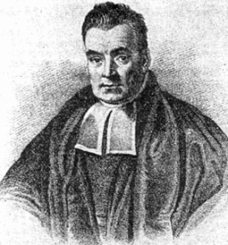
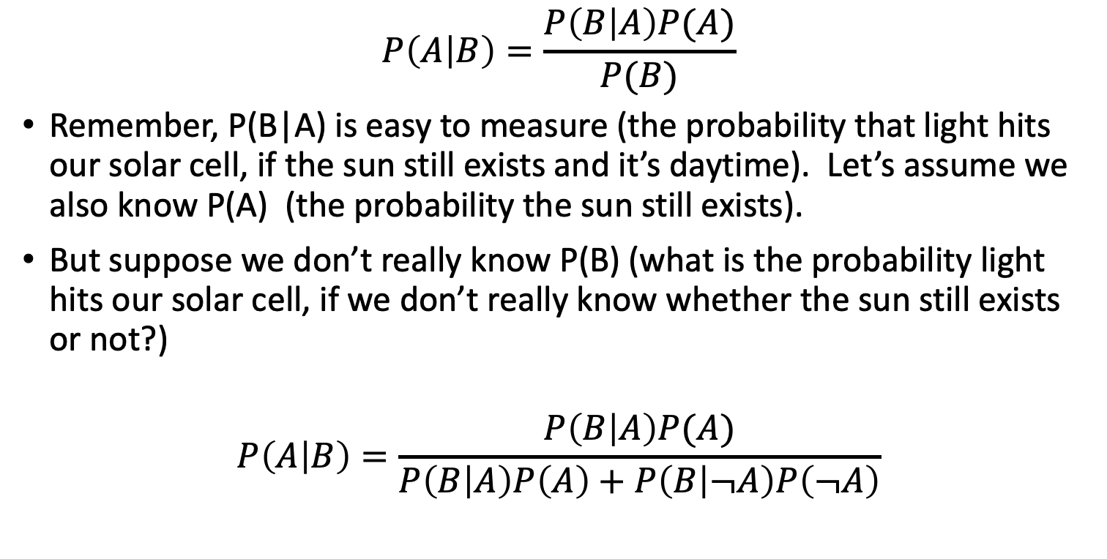
The More Useful Version of Bayes’ Rule
$$P\left(A | B\right)=\frac{P\left(B | A\right)P(A)}{P(B)}$$
Remember, P(B|A) is easy to measure (the probability that light hits our solar cell, if the sun still exists and it’s daytime). Let’s assume we also know P(A) (the probability the sun still exists).
But suppose we don’t really know P(B) (what is the probability light hits our solar cell, if we don’t really know whether the sun still exists or not?)
$$P\left(A | B\right)=\frac{P\left(B | A\right)P(A)}{P\left(B | A\right)P\left(A\right)+P\left(B | ¬A\right)P\left(¬A\right)}$$
This version is what you
memorize.
Rev. Thomas Bayes (1702-1761)
This version is what you
actually use.
Notes:
A: some unobservable aspect of the world that we are trying to predict (query variable)
B: observable evidence

Slide 16
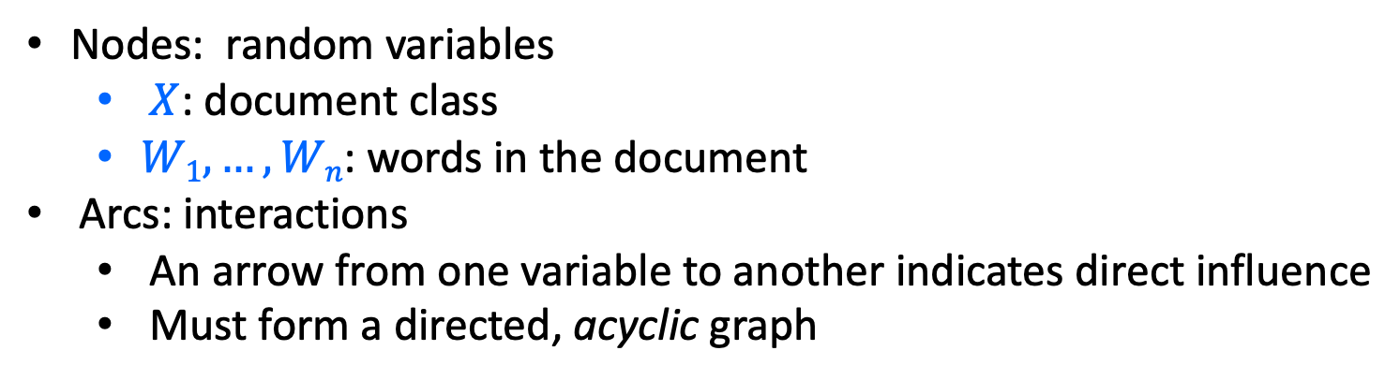
Bayesian Network: Structure and Parameters
Nodes: random variables
$X$: document class
$W1, …, Wn$: words in the document
Arcs: interactions
An arrow from one variable to another indicates direct influence
Must form a directed, acyclic graph
X
…
W₁
W₂
W_{n}

Slide 17
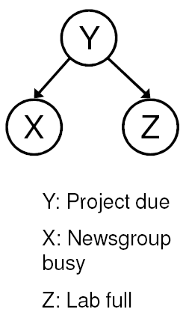
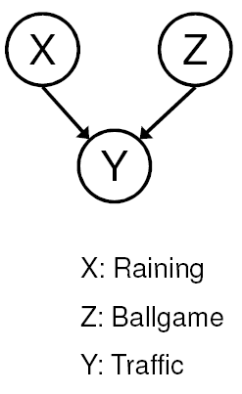
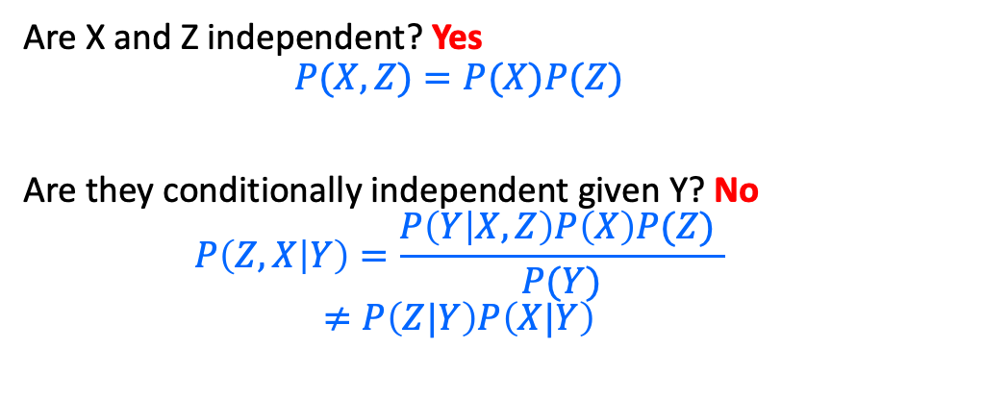
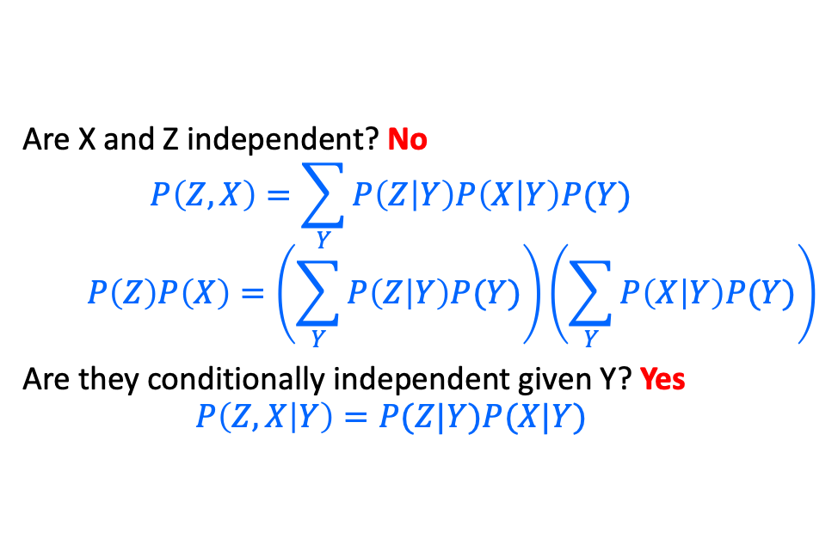
Conditional Independence ≠ Independence
Common cause: Conditionally Independent
Common effect: Independent
Are X and Z independent? No
$$P\left(Z,X\right)=\sum_{Y}{P\left(Z | Y\right)P\left(X | Y\right)P(Y)}$$
$$P\left(Z\right)P\left(X\right)=\left(\sum_{Y}{P\left(Z | Y\right)P(Y)}\right)\left(\sum_{Y}{P\left(X | Y\right)P(Y)}\right)$$
Are they conditionally independent given Y? Yes
$$P\left(Z,X | Y\right)=P(Z|Y)P(X|Y)$$
Are X and Z independent? Yes
$$P(X,Z)=P(X)P(Z)$$
Are they conditionally independent given Y? No
$$P\left(Z,X | Y\right)=\frac{P\left(Y | X,Z\right)P\left(X\right)P(Z) }{P(Y)}$$
$$≠P\left(Z|Y\right)P\left(X|Y\right)$$

Slide 18
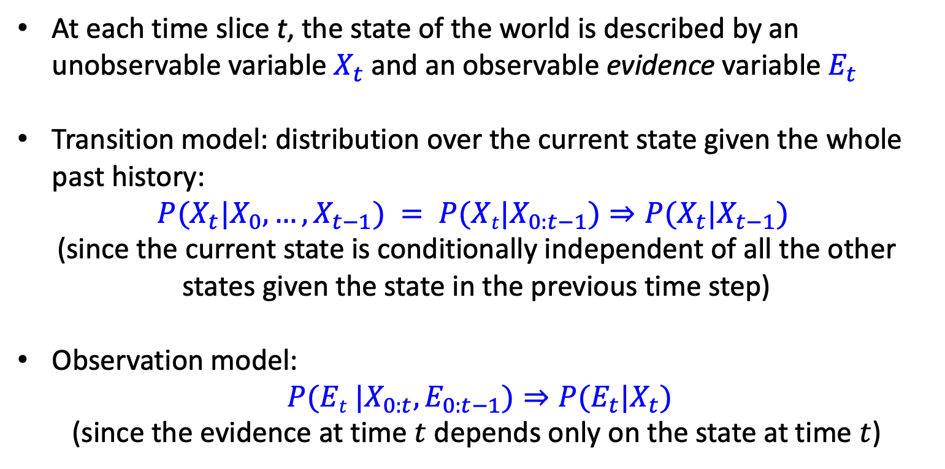
Hidden Markov Model (HMM)
At each time slice t, the state of the world is described by an unobservable variable $X_{t}$ and an observable evidence variable $E_{t}$
Transition model: distribution over the current state given the whole past history:
$$P(X_{t}|X_{0}, …,X_{t−1}) = P(Xt|X_{0:t−1})⇒P({X_{t}|X}_{t−1})$$
(since the current state is conditionally independent of all the other states given the state in the previous time step)
Observation model:
$P(Et |X_{0:t},E_{0:t−1})⇒P(E_{t}|X_{t})$
(since the evidence at time $t$ depends only on the state at time $t$)

Slide 19
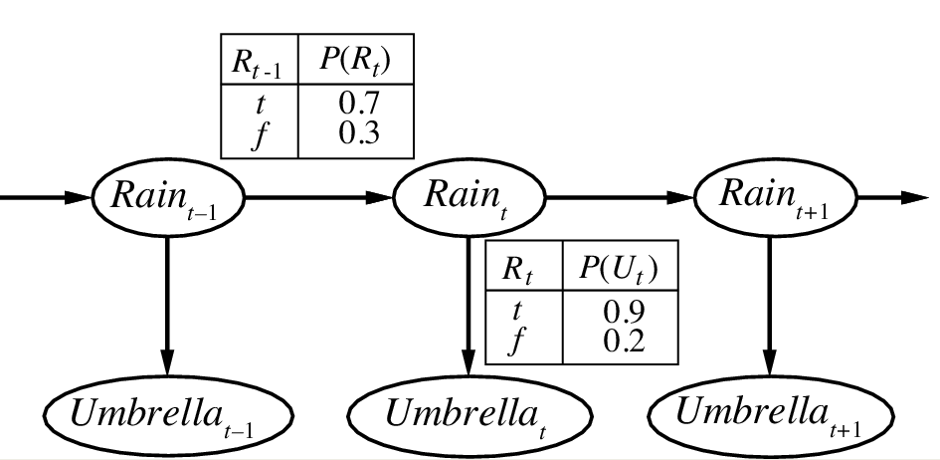
HMM Example
Transition model
state
evidence
Observation model

Slide 20
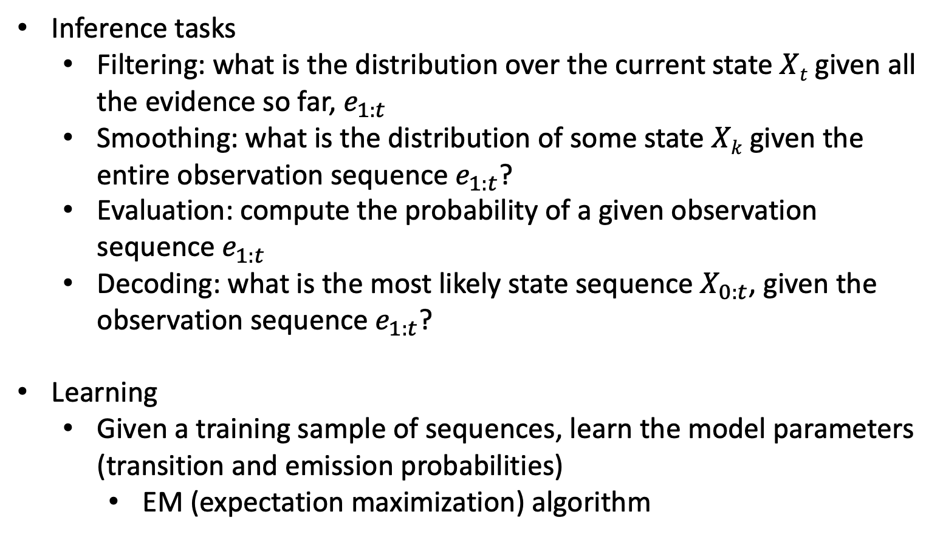
HMM Inference Tasks and Learning
Inference tasks
Filtering: what is the distribution over the current state $Xt$ given all the evidence so far, $e_{1:t}$
Smoothing: what is the distribution of some state $Xk$ given the entire observation sequence${ e}_{1:t}$?
Evaluation: compute the probability of a given observation sequence${ e}_{1:t}$
Decoding: what is the most likely state sequence${ X}_{0:t}$, given the observation sequence $e_{1:t}$?
Learning
Given a training sample of sequences, learn the model parameters (transition and emission probabilities)
EM (expectation maximization) algorithm

Slide 21
Outline: Final Review
Key Concept Part I
Key Concept Part II
Key Concept Part III
Key Concept Part IV
Final Agenda

Slide 22
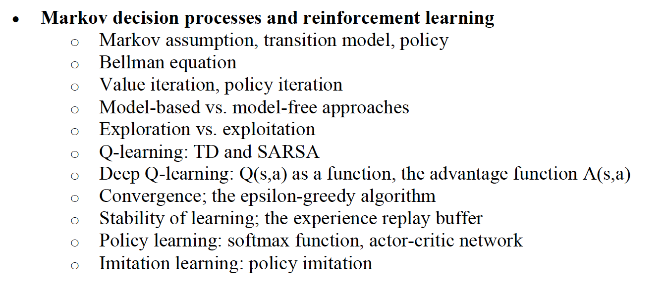
Key Concepts Part III

Slide 23
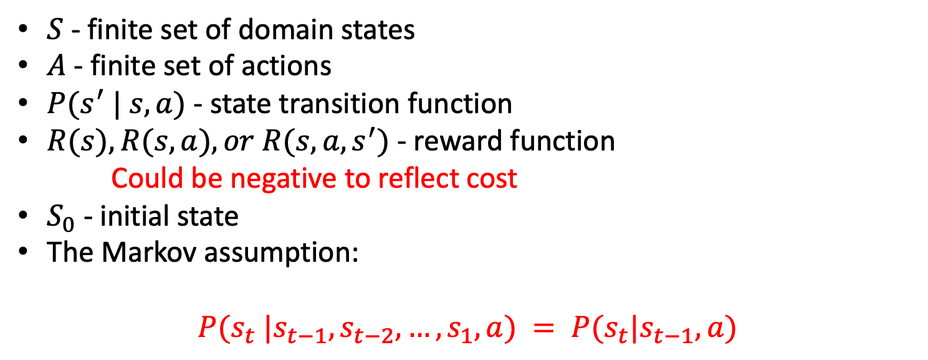
Markov Decision Process (MDP)
$S$- finite set of domain states
$A$- finite set of actions
$P(s^{′} | s, a)$- state transition function
$R(s), R(s, a), or R(s, a, s^{′})$- reward function
Could be negative to reflect cost
$S_{0}$- initial state
The Markov assumption:
$$P(s_{t} |s_{t−1}, s_{t−2}, …,s_{1}, a) = P(s_{t}|s_{t−1}, a)$$

Slide 24
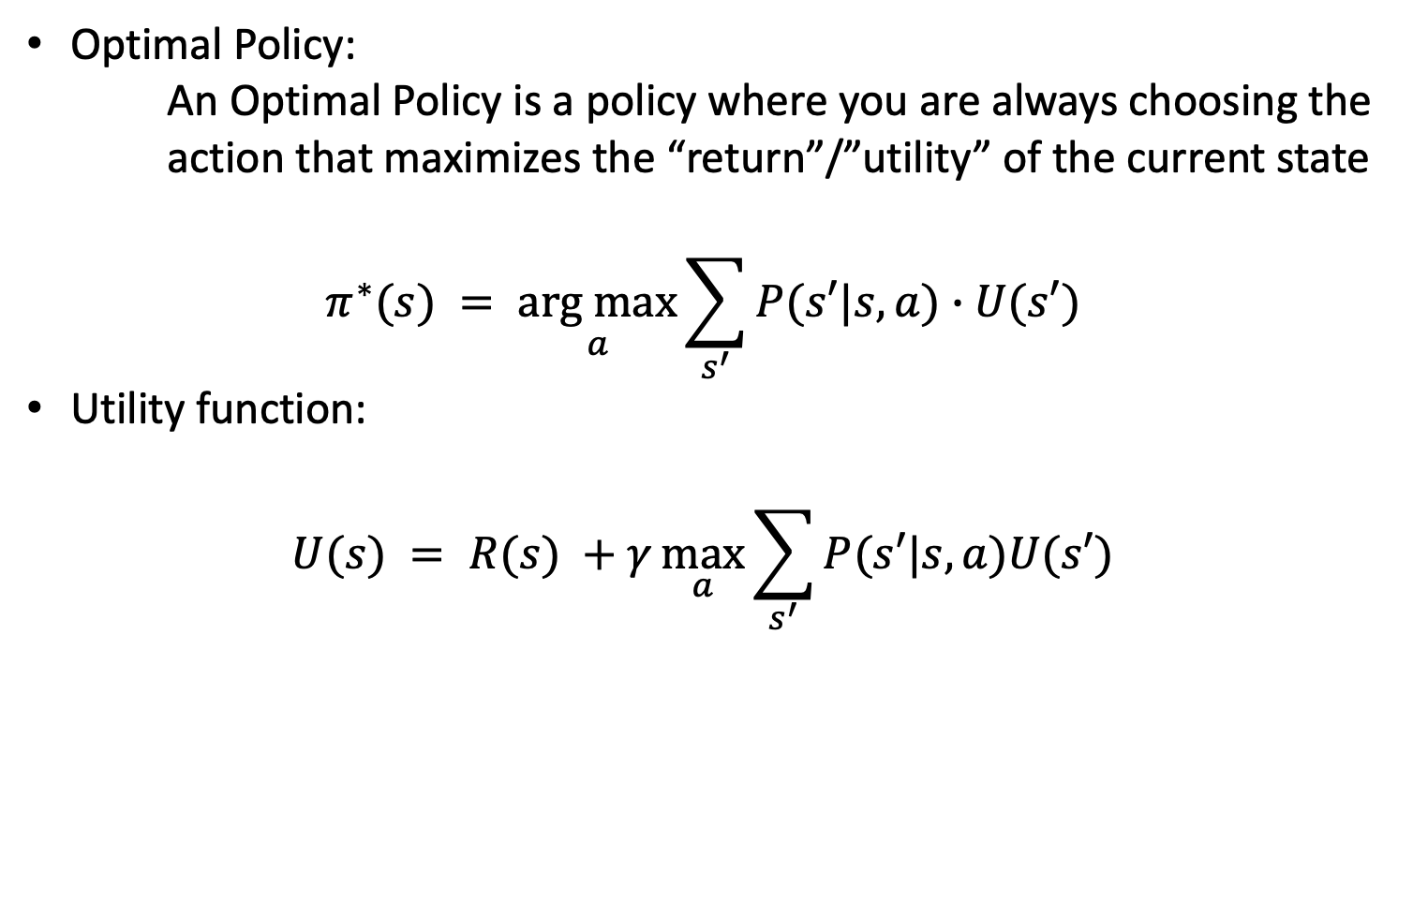
Computing Optimal Policy: the Bellman Equation
Optimal Policy:
An Optimal Policy is a policy where you are always choosing the action that maximizes the “return”/”utility” of the current state
$$π^{∗}(s) = \underset{a}{arg max}{\sum_{s^{′}}{P(s′|s,a)∙U(s′)}}$$
Utility function:
$$U(s) = R(s) +γ\max_{a}{\sum_{s^{′}}{P(s′|s, a)U(s′)}}$$

Slide 25
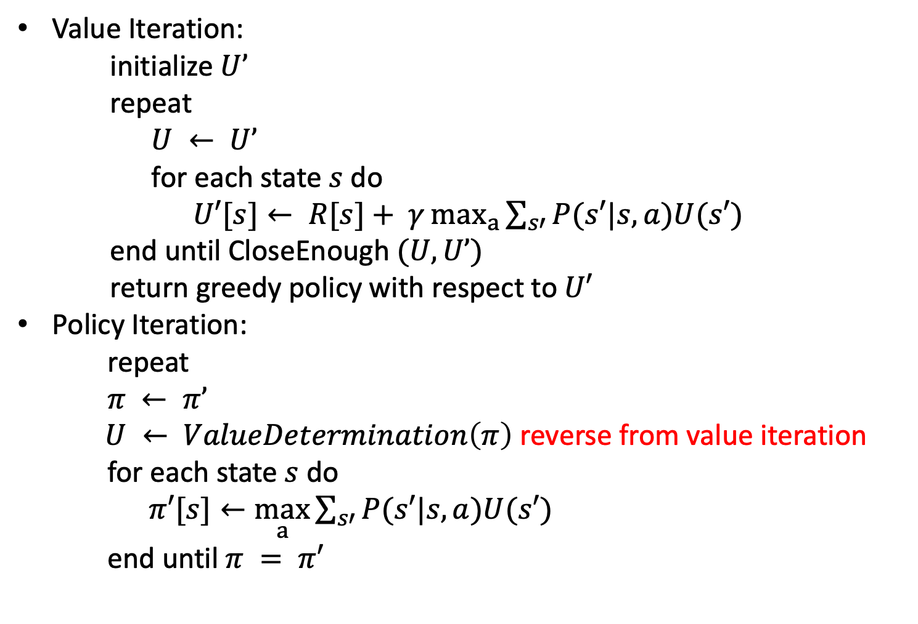
Value Iteration and Policy Iteration
Value Iteration:
initialize $U’$
repeat
$U ← U’$
for each state $s$ do
$U′[s]← R[s]+ γ\max_{a}{\sum_{s′}{P(s′|s,a)U(s′)}}$
end until CloseEnough $(U,U’)$
return greedy policy with respect to $U′$
Policy Iteration:
repeat
$π ← π’$
$U ← ValueDetermination\left(π\right)$ reverse from value iteration
for each state $s$ do
$π′[s]←\max_{a}{\sum_{s′}{P(s′|s,a)U(s′)}}$
end until $π = π′$

Slide 26
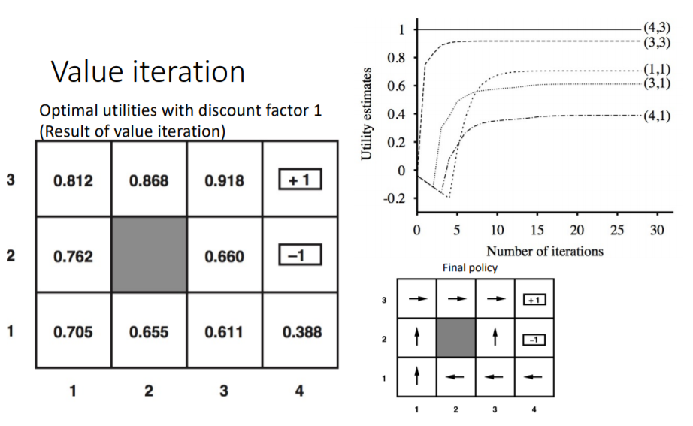
Value Iteration and Policy Iteration
VI Example:

Slide 27
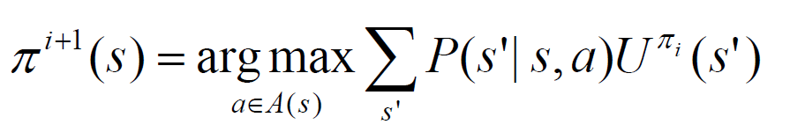
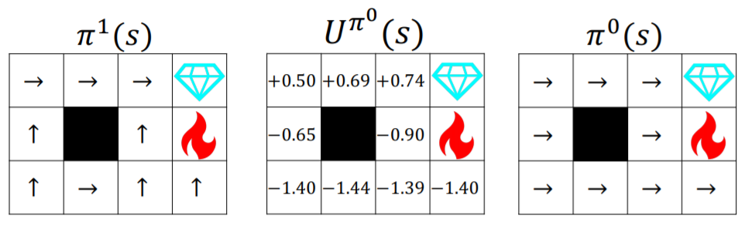
Value Iteration and Policy Iteration
PI Example:

Slide 28
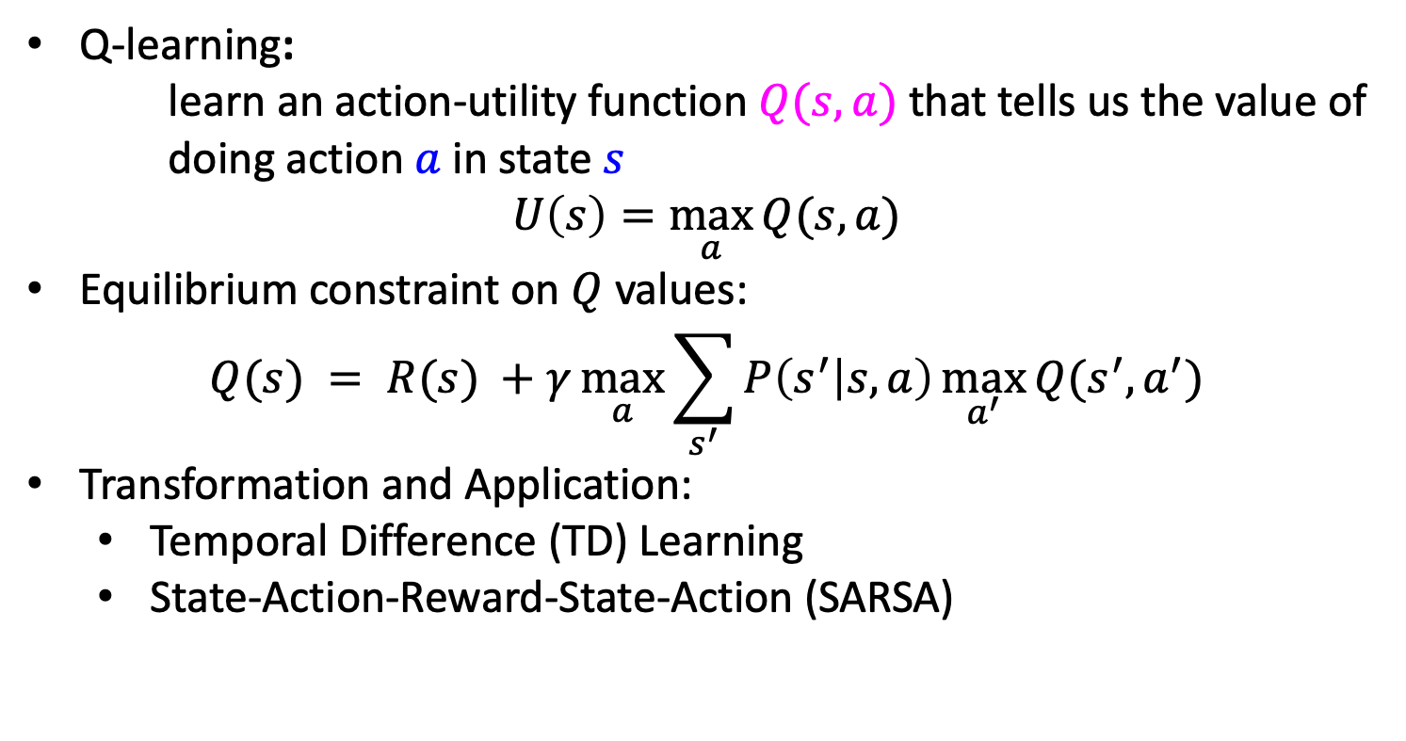
Q-Learning
Q-learning:
learn an action-utility function $Q(s,a)$that tells us the value of doing action $a$ in state $s$
$$U\left(s\right)=\max_{a}{Q(s,a)}$$
Equilibrium constraint on $Q$ values:
$$Q(s) = R(s) +γ\max_{a}{\sum_{s^{′}}{P\left(s^{′} | s, a\right)\max_{a^{′}}{Q(s^{′},a^{′})}}}$$
Transformation and Application:
Temporal Difference (TD) Learning
State-Action-Reward-State-Action (SARSA)

Slide 29
Outline: Final Review
Key Concept Part I
Key Concept Part II
Key Concept Part III
Key Concept Part IV
Final Agenda

Slide 30
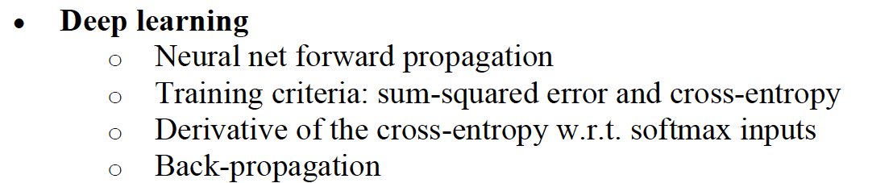
Key Concepts Part IV
Natural language processing and Speech processing
Lexical semantics
• Wordforms, lemmas & word senses; Synonymy & similarity
• Vector semantics: CBOW and skip-gram
• Generative training vs. Contrastive training
• Implicit meaning representations in lexical semantic spaces
Sentence semantics
• Recurrent neural networks (RNN)
• Attention, transformer
Automatic speech recognition

Slide 31
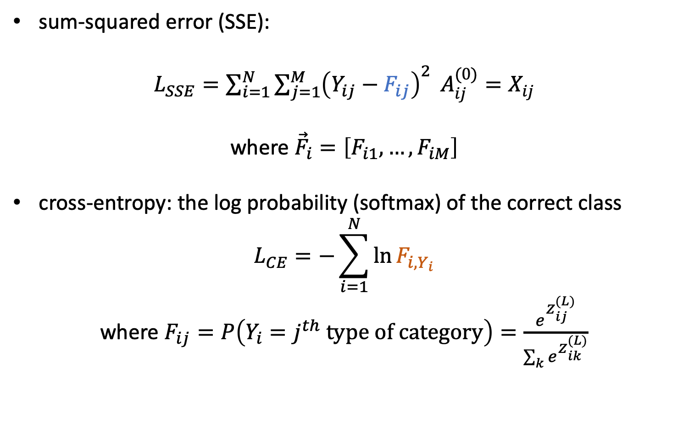
Loss Functions (Testing the Neural Net)
sum-squared error (SSE):
$L_{SSE}=\sum_{i=1}^{N}{\sum_{j=1}^{M}{{\left(Y_{ij}−F_{ij}\right)}^{2}}} A_{ij}^{(0)}=X_{ij}$
where ${\vec{F}}_{i}=\left[F_{i1},…,F_{iM}\right]$
cross-entropy: the log probability (softmax) of the correct class
$$L_{CE}=−\sum_{i=1}^{N}{\ln{F_{i,Y_{i}}}}$$
where $F_{ij}=P\left(Y_{i}=j^{th} type of category\right)=\frac{e^{Z_{ij}^{(L)}}}{\sum_{k}{e^{Z_{ik}^{(L)}}}}$

Slide 32
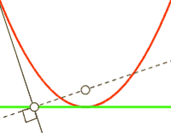
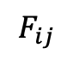
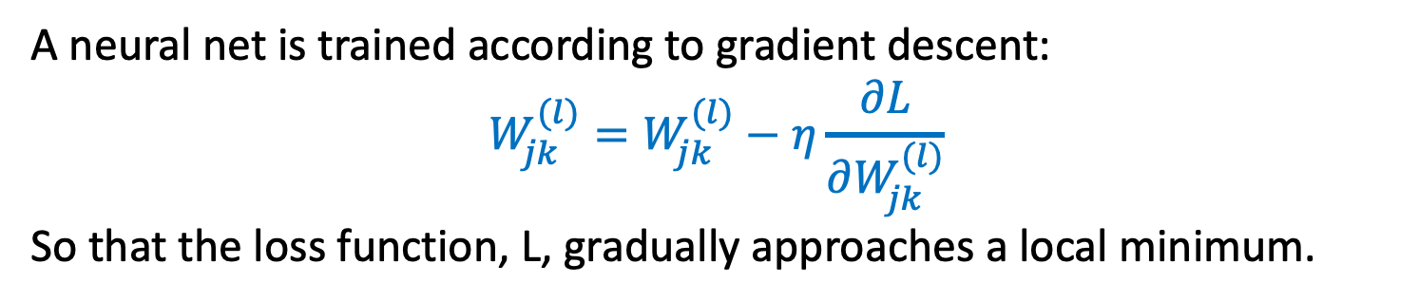
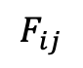


Back-Propagation (Training the Neural Net)
A neural net is trained according to gradient descent:
$$W_{jk}^{(l)}=W_{jk}^{(l)}−η\frac{∂L}{∂W_{jk}^{(l)}}$$
So that the loss function, L, gradually approaches a local minimum.
Loss
(j is the
right
answer)
Loss
(j is the
wrong
answer)
$$F_{ij}$$
$$0$$
$$F_{ij}$$
$$1$$

Slide 33
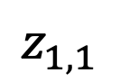
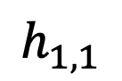
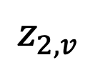
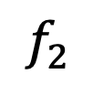
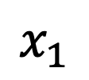
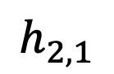


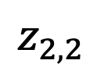
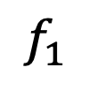
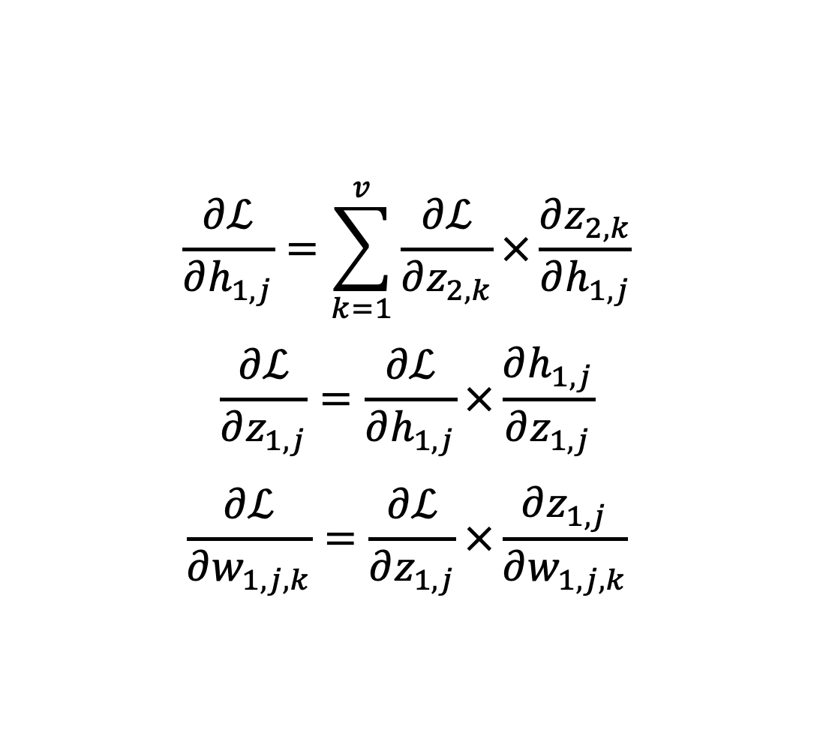
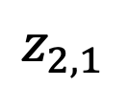
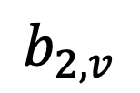

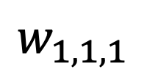

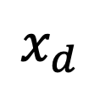
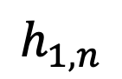
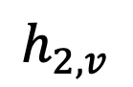
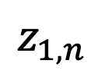
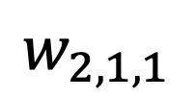
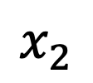




Back-Propagation (Chain rule)
$$\frac{∂ℒ}{∂h_{1,j}}=\sum_{k=1}^{v}{\frac{∂ℒ}{∂z_{2,k}}×\frac{∂z_{2,k}}{∂h_{1,j}}}$$
$$\frac{∂ℒ}{∂z_{1,j}}=\frac{∂ℒ}{∂h_{1,j}}×\frac{∂h_{1,j}}{∂z_{1,j}}$$
$$\frac{∂ℒ}{∂w_{1,j,k}}=\frac{∂ℒ}{∂z_{1,j}}×\frac{∂z_{1,j}}{∂w_{1,j,k}}$$
$$f_{1}$$
$$f_{2}$$
$$f_{v}$$
$$h_{2,1}$$
$$h_{2,2}$$
$$…$$
$$h_{2,v}$$
$$z_{2,1}$$
$$z_{2,2}$$
$$z_{2,v}$$
$$b_{2,v}$$
$$w_{2,1,1}$$
$$h_{1,1}$$
$$h_{1,2}$$
$$…$$
$$1$$
$$h_{1,n}$$
$$z_{1,1}$$
$$z_{1,2}$$
$$z_{1,n}$$
$$w_{1,1,1}$$
$$1$$
$$x_{1}$$
$$x_{2}$$
$$…$$
$$x_{d}$$

Slide 34

Back-Propagation (Chain rule)
The key to backpropagation is that each individual derivative is easy. For example, if $ℒ$ is cross-entropy and $f(x)=σ\left(z_{2}\right)$, then you already know that
$$\frac{∂ℒ}{∂z_{2,k}}=f_{k}\left(x\right)−{\text{𝟙}}_{y=k}$$
Since $z_{2}=w_{2}h_{1}$ is just a matrix multiplication,
$$\frac{∂z_{2,k}}{∂h_{1,j}}=w_{2,k,j}$$
… and the derivative of ReLU is the unit step:
$$\frac{∂h_{1,j}}{∂z_{1,j}}=u\left(z_{1,j}\right)$$
$$f_{1}$$
$$f_{2}$$
$$f_{v}$$
$$h_{2,1}$$
$$h_{2,2}$$
$$…$$
$$h_{2,v}$$
$$z_{2,1}$$
$$z_{2,2}$$
$$z_{2,v}$$
$$b_{2,v}$$
$$w_{2,1,1}$$
$$h_{1,1}$$
$$h_{1,2}$$
$$…$$
$$1$$
$$h_{1,n}$$
$$z_{1,1}$$
$$z_{1,2}$$
$$z_{1,n}$$
$$w_{1,1,1}$$
$$1$$
$$x_{1}$$
$$x_{2}$$
$$…$$
$$x_{d}$$

Slide 35

Natural language processing

Slide 36

Natural language processing

Slide 37

Natural language processing

Slide 38
Outline: Final Review
Key Concept Part I
Key Concept Part II
Key Concept Part III
Key Concept Part IV
Final Agenda

Slide 39

ECE 448 Sp2023 Destination
Good Luck!!
&
See you all in the exam.

